Slide 1
Audio Acoustic Assistant
Mid-Point Presentation
Group 14

Slide 2
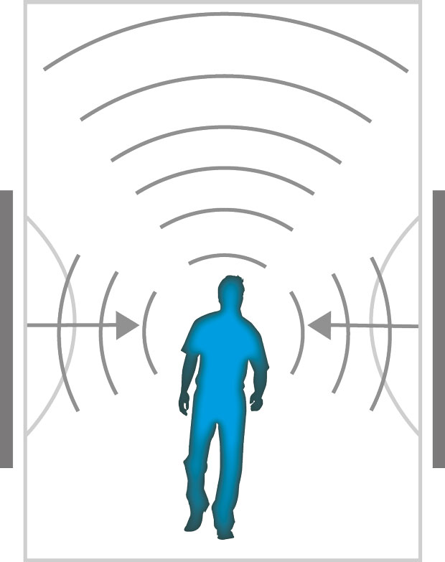
Who are Audiotronics
Background
Cedric, previously a sound engineer
Promoters
Cedric Vecchionacce - Managing Director
Sales & Marketing
Colin Allen - Vice-President
Finance Manager
Keith Feeney – Vice-President
Humans Resources
Patrick Lawlor - Vice-President
Marketing Analyst
Fearghal McMorrow – Vice-President
Production & Operations Manager
(KNAUF DANOLINE A/S, n.d.)

Slide 3

Android App idea – “Audio Acoustic Assistant”
Origins
Branched from Cedric’s background
Cedric and Keith created a acoustic calculator website in late 2015
Why it was decided to make this app?
Idea was born from the website
Website is not mobile and is bulky
Website could not take sound inputs
Wanted to develop an mobile app, new technology
Promoter’s expertise were geared towards Android
(Java, Python, etc.)
(AppFutura & montse, 2016)

Slide 4
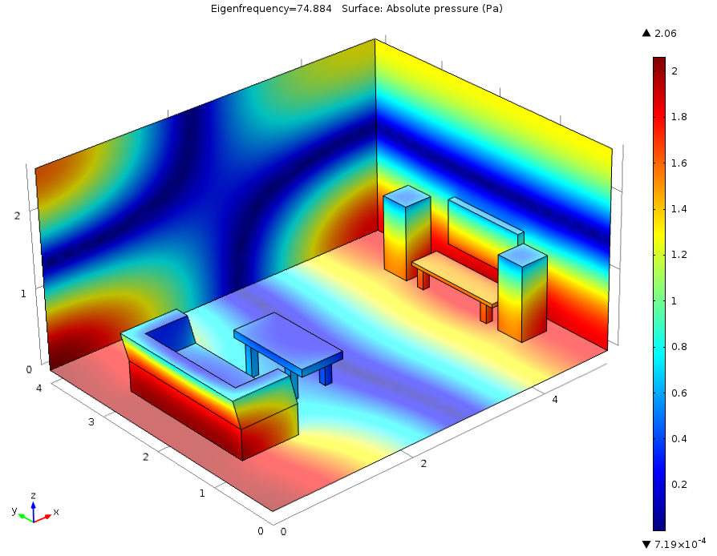
App Overview
What does the app do?
Acoustic treatment.
Input from user. (volume/sound)
Finding their RT60.
Determine the length of a sound until it disappears.
Calculate the correct reverb time.
Compare to ideal RT60.
Advice to improve their RT60.
(Mads Herring Jensen & COMSOL Inc, 2015)

Slide 5

Marketing
Who are our target audience?
Online video content creators.
Both established and Amateur content creators.
Who are our competitors?
Only one.
Focused on teaching the calculation.
Poorly designed, crashes often.

Slide 6

Cost & Finance
Where do we get our money?
Invested €10k each.
€50k loan at 7%.
€10k bank overdraft.
How is it spent?
€16, 725 before sales.
Total cost of 20k a month.
Sells for €5, we receive €3.50 after Tax/Google.

Slide 7

Progress on the Project
What has been done?
Proposal
Requirements
Android Studio - Tutorials
What is happening now?
Android Studio – coding
What is next?
Android Studio – more coding
Testing
Implementation
Final submission
(Software Plant, 2017)

Slide 8
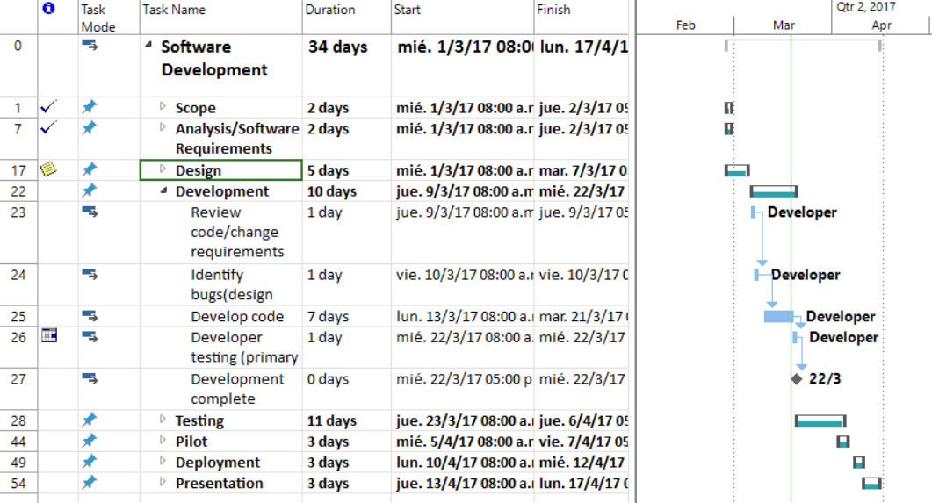
Work Breakdown Structure
Used with permission from Microsoft.

Slide 9
Demonstration of the App

Slide 10
References
KNAUF DANOLINE A/S, n.d., image, viewed March 2017, <http://knaufdanoline.com/properties/acoustics/>.
Mads Herring Jensen & COMSOL Inc, 2015, image, viewed March 2017, <https://www.comsol.com/blogs/modeling-room-acoustics-with-comsol-multiphysics/>.
Software Plant, 2017, image, viewed March 2017, <http://www.softwareplant.com/migrating-ms-project-jira/>.
canadian1strealty, 2012, photograph, viewed March 2017, <https://canadian1strealty.wordpress.com/2012/11/13/5-nice-things-we-can-do-for-our-clients/
MS Office, 2017, WBS crated march 2017.

Slide 11

Audio Acoustic Assistant
Colin Allen,
Keith Feeney,
Patrick Lawlor,
Fearghal McMorrow,
Cedric Vecchionacce
(canadian1strealty, 2012)

